Slide 1
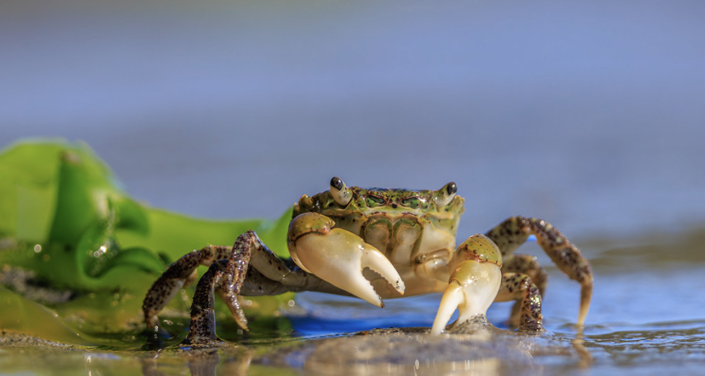
Effects of copper contamination on Hemigrapsus oregonensis
Kashf Iqbal, Caiden Fukano, Stevan Pekich, and Adrian Shaw

Slide 2
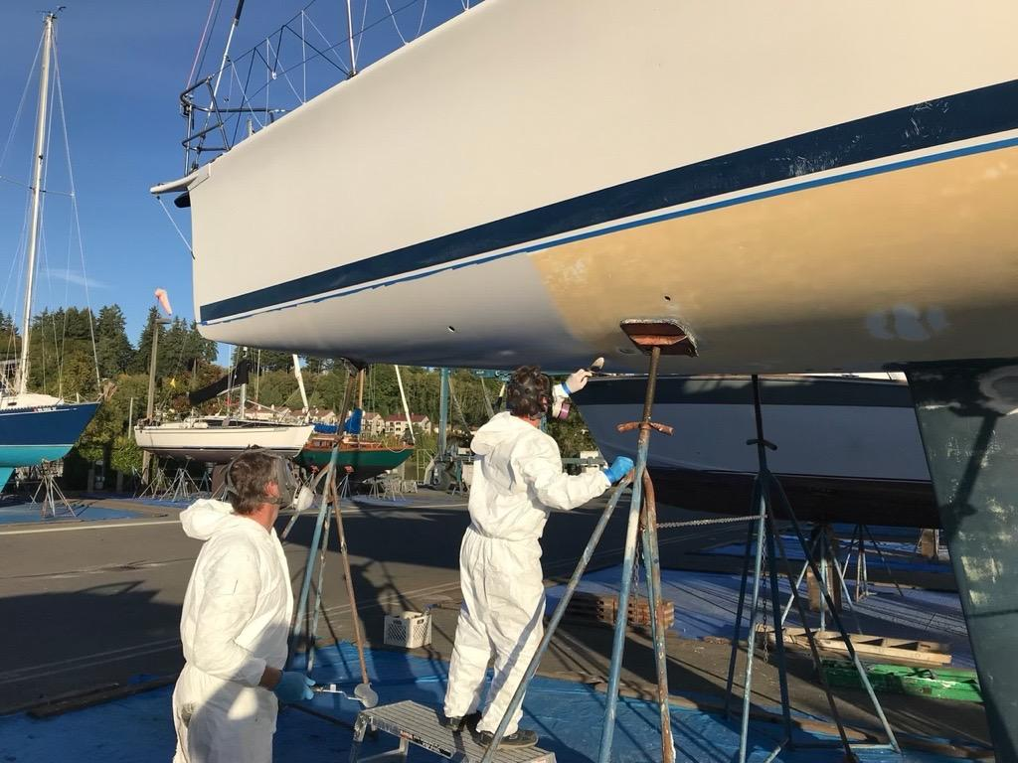
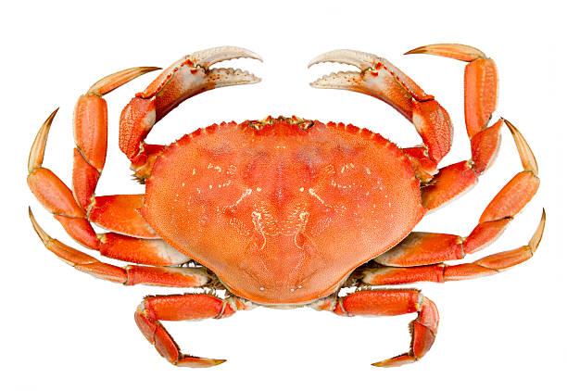
Introduction- Copper Pollution
State of Washington Department of Ecology
Copper ingested and absorbed by crabs have a wide range of toxic effects: reduced growth, oxidative stress, inhibited senses.
Commercial fishing and human health consequences in the Puget Sound
Natural Sources: weathering, volcanoes, geological deposits. Coastal water levels low.
Human Sources: Agriculture, industrial processes, antifouling paints. Urban coastal water levels high.

Slide 3
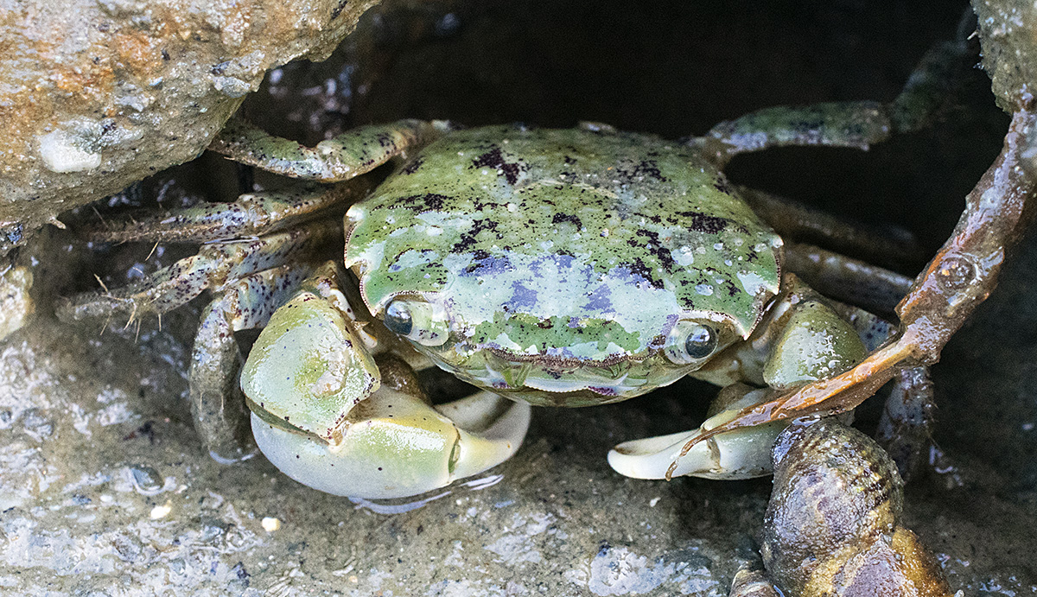
Background- What’s known?
Ocean copper levels rising, and copper is making its way inside of Puget Sound crabs (Carey et al. 2014, Dagdag et al. 2023)
Copper impairs metabolism, behavior, and osmoregulation in crustaceans (Hansen et al. 1992, Krång & Ekerholm 2006; Lara Jacobo et al. 2016)
There is a call for research on copper’s effects on marine organisms in the Puget Sound to guide legislation (Washington State Department of Ecology 2019, La Colla et al. 2018)
Cu
How will copper pollution affect a model organism crab exactly?

Slide 4
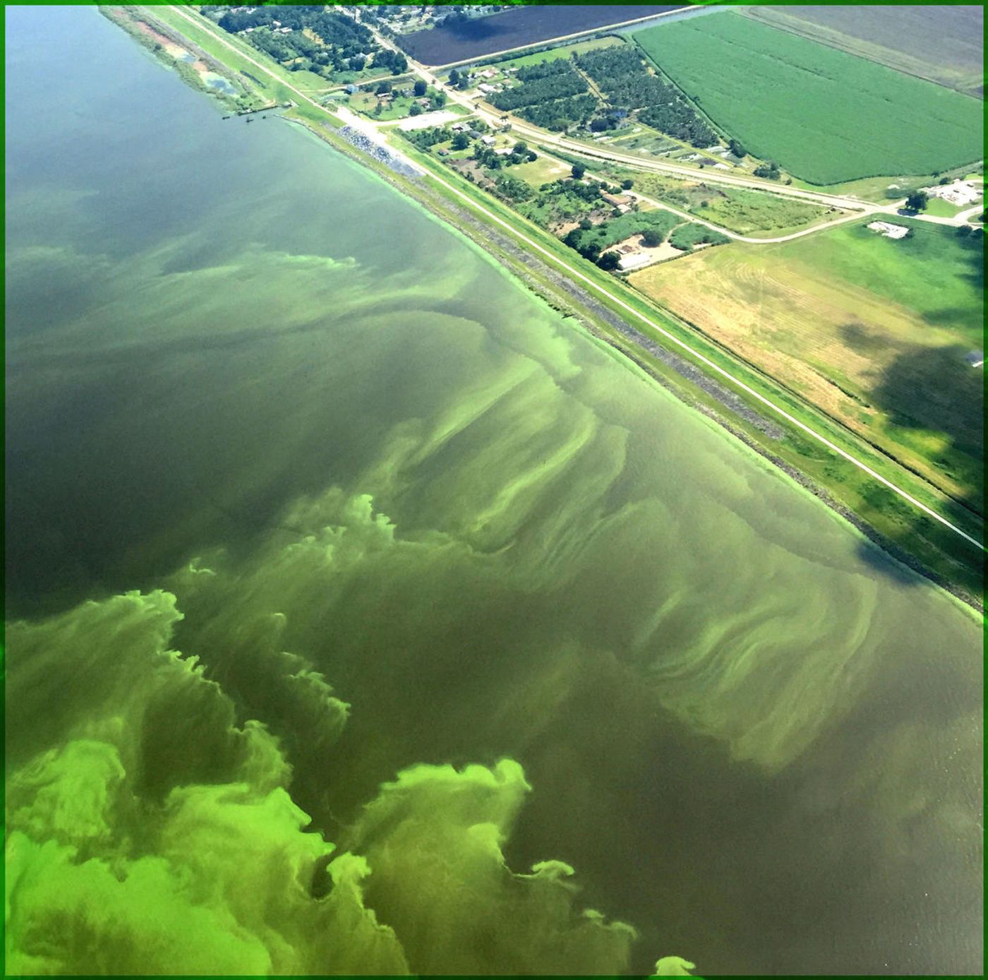
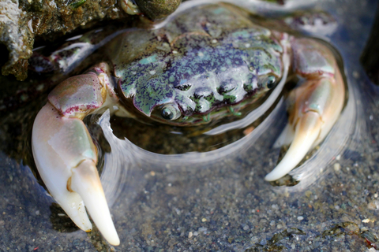
Research Question / Hypotheses
Research question: What are the physiological effects of copper exposure on Hemigrapsus oregonensis, assessed through metabolic and behavioral indicators?
Alternative Hypothesis: Copper exposure significantly affects the physiological (metabolic rate) and behavioral (righting time) responses of Hemigrapsus oregonensis, with greater copper concentrations leading to more pronounced effects.
Null Hypothesis: Copper exposure has no significant effect on the physiological (metabolic rate) or behavioral (righting time) responses of Hemigrapsus oregonensis across different concentration levels.

Slide 5
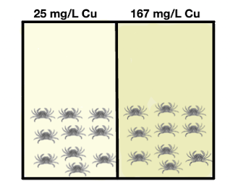
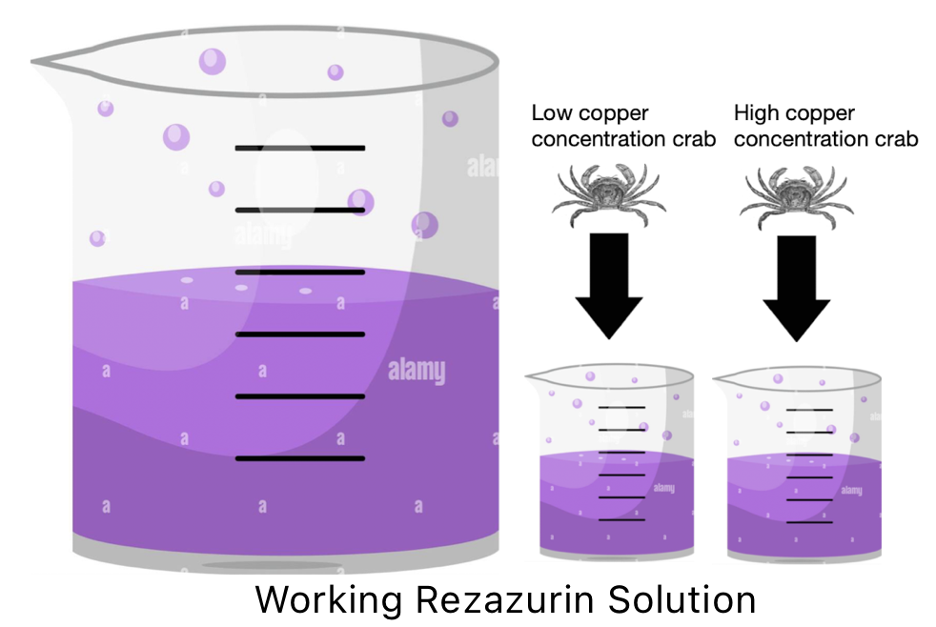
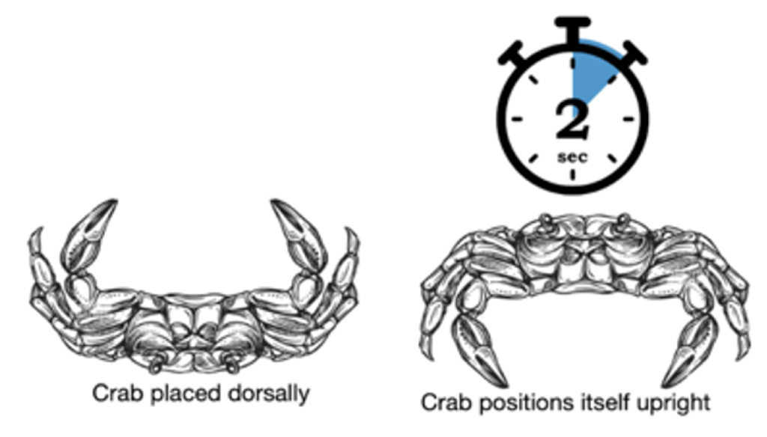
Experimental Design & Methods
Experimental Design Overview:
Copper source: Copper sulfate pentahydrate (CuSO₄·5H₂O), dissolved in seawater
Treatment groups (Fig. 1):
Control: 0 mg/L Cu
Low: 25 mg/L Cu
High: 167 mg/L Cu
Replicates:
9 H. oregonensis per treatment
≥ 20 individuals in control; total ≥ 38 crabs
Tanks maintained with constant salinity, temperature, pH, and dissolved oxygen
Metabolic stress test:
Respirometry using resazurin dye
After 7 & 14 days, crabs placed in sealed chambers with 35 mL resazurin (Fig. 2)
200 µL samples taken every 30 mins; fluorescence measured
Values normalized to crab weight; faster color change = higher oxygen consumption
Behavioral test:
Righting time measured on days 7 & 14 (Fig. 3)
Crabs placed upside down; time to self-right recorded
Conducted in control-condition seawater
Indicates potential motor or defensive impairment
Data analyzed using Microsoft Excel and RStudio
Figure 1. Copper exposure treatments for H. oregonensis. Copper sulfate pentahydrate (CuSO₄·5H₂O) was used to create two concentration groups: low (25 mg/L Cu), and high (167 mg/L Cu). Each treatment group contained 9 crabs, while the control tank contained ≥ 20 or more crabs, totaling ≥ 38 individuals. Tanks were kept under consistent water quality conditions.
Figure 2. Respirometry using resazurin to measure metabolic rate in H. oregonensis. Individual crabs were placed in sealed chambers containing resazurin solution, and the rate of color change from blue (resazurin) to pink (resorufin) was a representation of aerobic metabolic rate Values were normalized to crab weight. Faster color changes indicated higher oxygen consumption and stress.
Figure 3. Righting response test for H. oregonensis. Crabs were flipped onto their dorsal side, and the time to self-right was recorded. Longer righting times indicated potential behavioral impairment from copper exposure.
Notes:
Justify here that “Copper sulfate pentahydrate (CuSO₄·5H₂O), commonly used in previous studies, was selected as the source of copper exposure, which was dissolved in seawater to reach desired concentrations (Xu et al. 2025).”

Slide 6
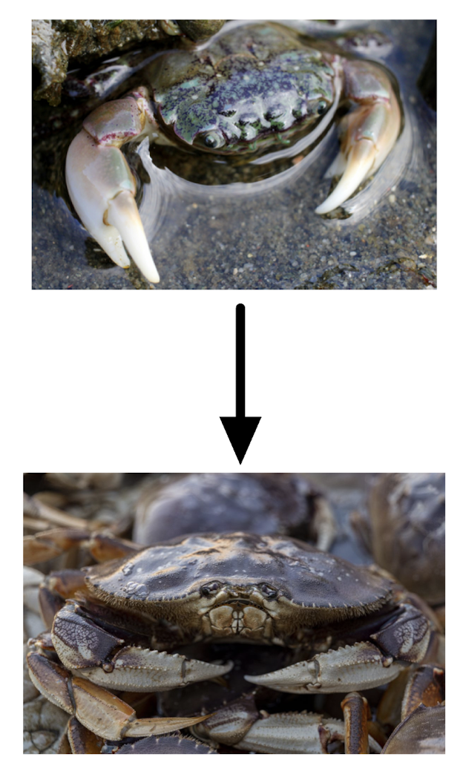
Justification
Why This Design?
Comprehensive: Detect both physiological (metabolic rate) and behavioral (righting time) effects
Three copper levels (control, low, high) test for dose-dependent responses
Why This Species?
The yellow shore crab (Hemigrapsus oregonensis)
Found in areas affected by copper pollution: marinas where antifouling paints leach copper into the water (Hobbs et al. 2022)
Exposed through ingestion and absorption of copper from the environment
Relevant to ecological risk assessments and conservation of other coastal invertebrates
Copper Source & Relevance
Compound: Copper sulfate pentahydrate (CuSO₄·5H₂O) dissolved in seawater
Commonly used in past studies on other crab species (Xu et al. 2025)
Real-world relevance
Agriculture: fungicide, algaecide (Benhalima et al. 2019)
Aquaculture: algae/parasite control (Watson & Yanong 2014)
Wastewater treatment (Burandt et al. 2024)

Slide 7
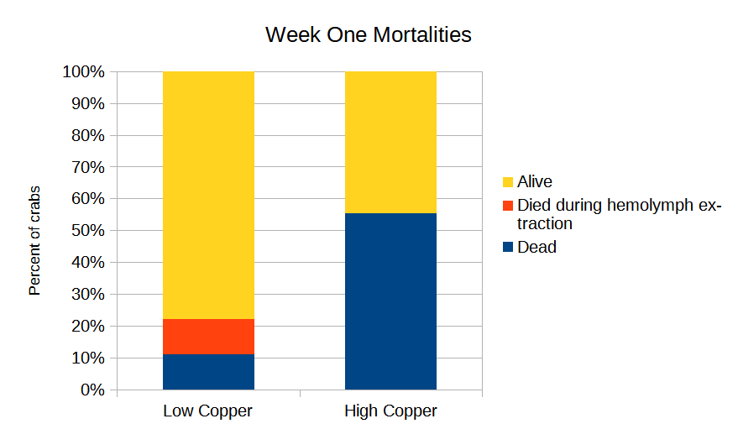
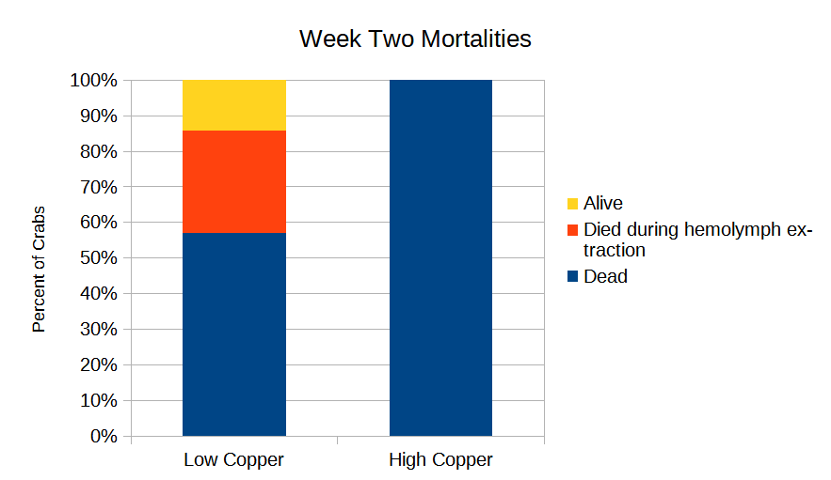
Mortalities
Crabs that died during the resazurin assay are counted as dead due to the treatment

Slide 8
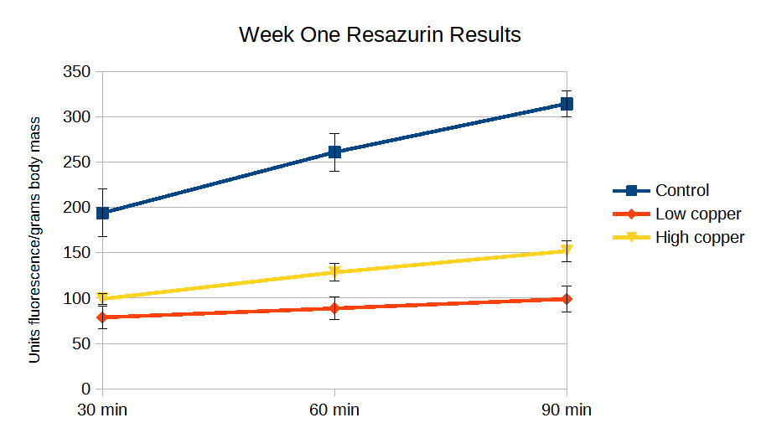
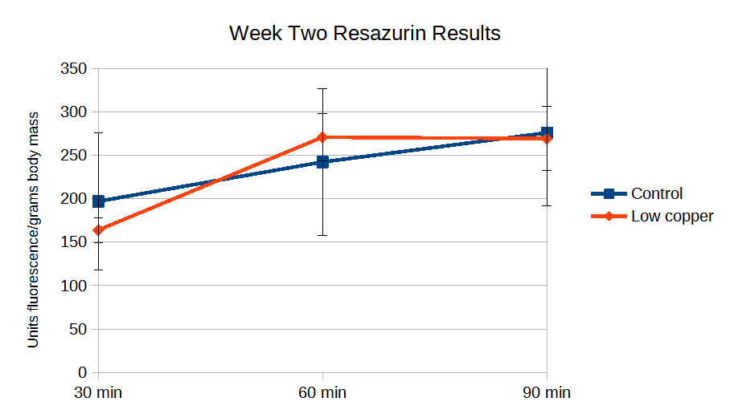
Resazurin
Three crabs per group tested week one with one high copper crab dying during the resazurin assay. Week two control was three crabs, low copper was four crabs, and high copper was one crab, with two low copper crabs and the high copper crab all dying. Data from dead crabs was excluded.

Slide 9
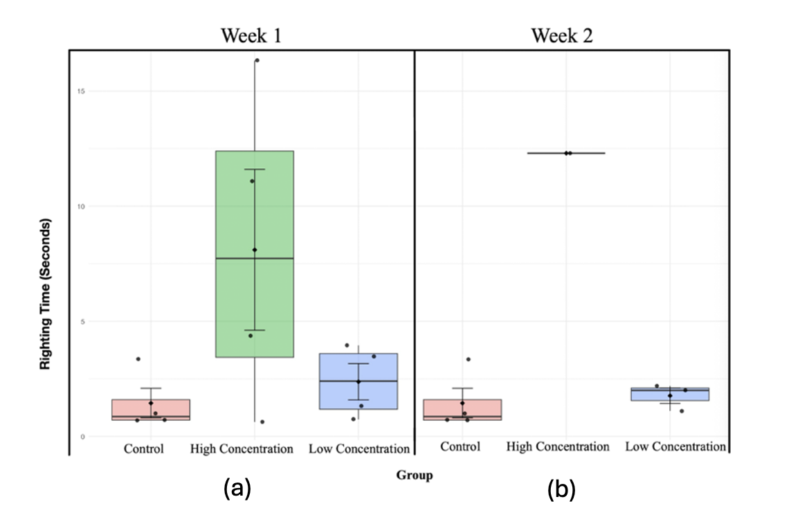
Righting Times
Both weeks are using the same control data. One low copper crab in week two is not included as it was unable to right itself and so does not have a righting time that could be shown.

Slide 10
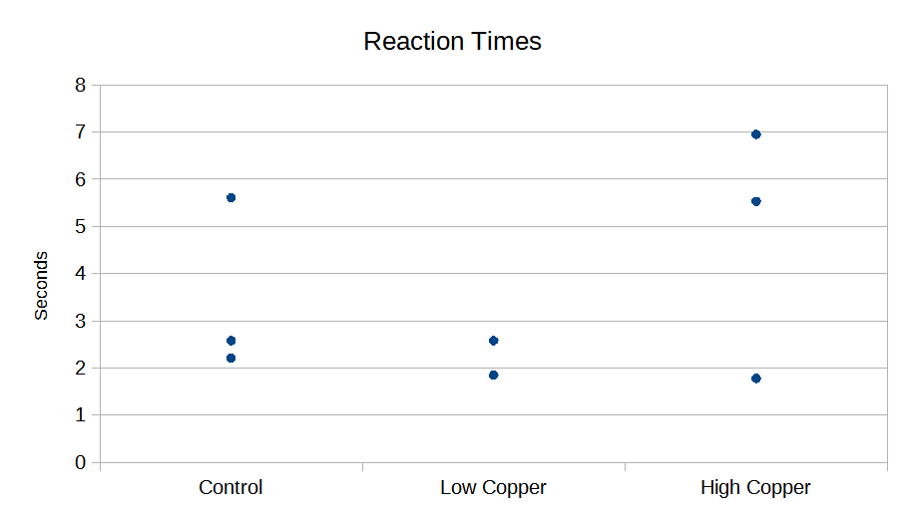
Threat Response
Reaction times of crabs who fled (three control, two low copper, three high copper). Crabs who froze not shown (one control, two low copper, one high copper)

Slide 11
Conclusions
Sample size a limiting factor
Mortalities a clear effect
Righting times inconclusive
Potential neurological effect
Resazurin also inconclusive
Week one clear difference between copper exposure and control
Week two no clear difference between groups
Difficulties with threat response
Outside distractions

Slide 12
Future Work
Larger sample sizes
High mortality rates shrunk already small sample size even further, making it challenging to collect useful data
Lower concentrations
Future studies that aim to study non fatal behavioral stressors should ensure copper concentrations in treatment tanks are not fatal
A determination of H. oregonensis LD50 could help inform future work.
Different form of copper?
Other forms of copper are more representative of copper contamination in the Salish Sea ecosystem
Potential use of antifouling paint flakes as copper substrate.
Modified experimental design for behavior
Fewer distractions
Potentially a different method for measuring reaction time

Slide 13
Literature
Elumalai, M., Antunes, C., & Guilhermino, L. (2005). Alterations of reproductive parameters in the crab Carcinus maenas after exposure to metals. Water, Air, and Soil Pollution, 160(1), 245-258. https://doi.org/10.1007/s11270-005-2992-9
Hobbs, W., McCall, M., and Lanksbury, J.A. (2019) Copper concentrations in five Puget Sound marinas. p. 67 in 2018 Salish Sea Toxics Monitoring Synthesis: A Selection of Research. Edited by C.A. James, R. Jordan, M. Langness, J. Lanksbury, D. Lester, S. O’Neill, K. Song, and C. Sullivan. Puget Sound Ecosystem Monitoring Program. Tacoma, WA. 88 pp: https://www.eopugetsound.org/articles/2018-salish-sea-toxics-monitoring-synthesis
Lara Jacobo, L., Díaz, F., Denisse Re, A., Galindo-Sanchez, C. E., Sanchez-Lizarraga, A. L., Nuñez-Moreno, L. A., & Moreno-Sierra, D. (2016). Physiological responses of the red rocky crab Cancer antennarius exposed to different concentrations of copper sulfate. Revista de Biología Marina y Oceanografía, 51(2), 327–336. https://doi.org/10.4067/S0718-19572016000200010
Kirici M. 2017. Toxic effects of copper sulphate pentahydrate on antioxidant enzyme activities and lipid peroxidation of freshwater fish Capoeta umbla (Heckel, 1843) tissues. Applied Ecology and Environmental Research 15, 1685–1696, doi: 10.15666/aeer/1503_16851696.
Krång, A.-S., & Ekerholm, M. (2006). Copper reduced mating behaviour in male shore crabs (Carcinus maenas (L.)). Aquatic Toxicology, 80(1), 60–69. https://doi.org/10.1016/j.aquatox.2006.07.014
Medesani, D. A., Greco, L. S. L., & Rodrı́guez, E. M. (2004). Interference of cadmium and copper with the endocrine control of ovarian growth, in the estuarine crab Chasmagnathus granulata. Aquatic Toxicology, 69(2), 165–174. https://doi.org/10.1016/j.aquatox.2004.05.003
Nnaji, N. D., Onyeaka, H., Miri, T., & Ugwa, C. (2023). Bioaccumulation for heavy metal removal: A review. SN Applied Sciences, 5(5), 125. https://doi.org/10.1007/s42452-023-05351-6
Reichmuth J.M., MacDonald J., Ramirez J. & Weis J.S. 2011. Fight or flight: an investigation of aggressive behavior and predator avoidance in two populations of blue crabs (Callinectes sapidus Rathbun) in New Jersey. Hydrobiologia 658, 173–182, doi: 10.1007/s10750-010-0460-z.
(Kubitza 2023)Benhalima L., Amri S., Bensouilah M. & Ouzrout R. 2019. Antibacterial effect of copper sulfate against multi-drug resistant nosocomial pathogens isolated from clinical samples: Effect of copper sulfate on clinical isolates. Pakistan Journal of Medical Sciences 35, doi: 10.12669/pjms.35.5.336.
Burandt Q.C., Deising H.B. & Von Tiedemann A. 2024. Further Limitations of Synthetic Fungicide Use and Expansion of Organic Agriculture in Europe Will Increase the Environmental and Health Risks of Chemical Crop Protection Caused by Copper-Containing Fungicides. Environmental Toxicology and Chemistry 43, 19–30, doi: 10.1002/etc.5766.
Watson C. & Yanong R. 2014. Use of Copper in Freshwater Aquaculture and Farm Ponds: FA-13/FA008, 8/2014. EDIS 2014, doi: 10.32473/edis-fa008-1989.
Xu J., Feng G. & Yan Y. 2025. Effects of polystyrene nanoplastics and copper on gill tissue structure, metabolism, and immune function of the Chinese mitten crab (Eriocheir sinensis). Frontiers in Marine Science12, 1538734, doi: 10.3389/fmars.2025.1538734.

